Slide 1
University Admission Information
Developed by
- Md. Ashikuzzaman
- Awal Ahmed Fime

Slide 2
University Admission Information
Introduction
Application system for combined admission
All the information at a same place.
Provide frequently asked questions section

Slide 3
University Admission Information
Introduction
Transport and accommodation information
A communication platform for students.
Interface for authority to provide their respected information as admin.

Slide 4
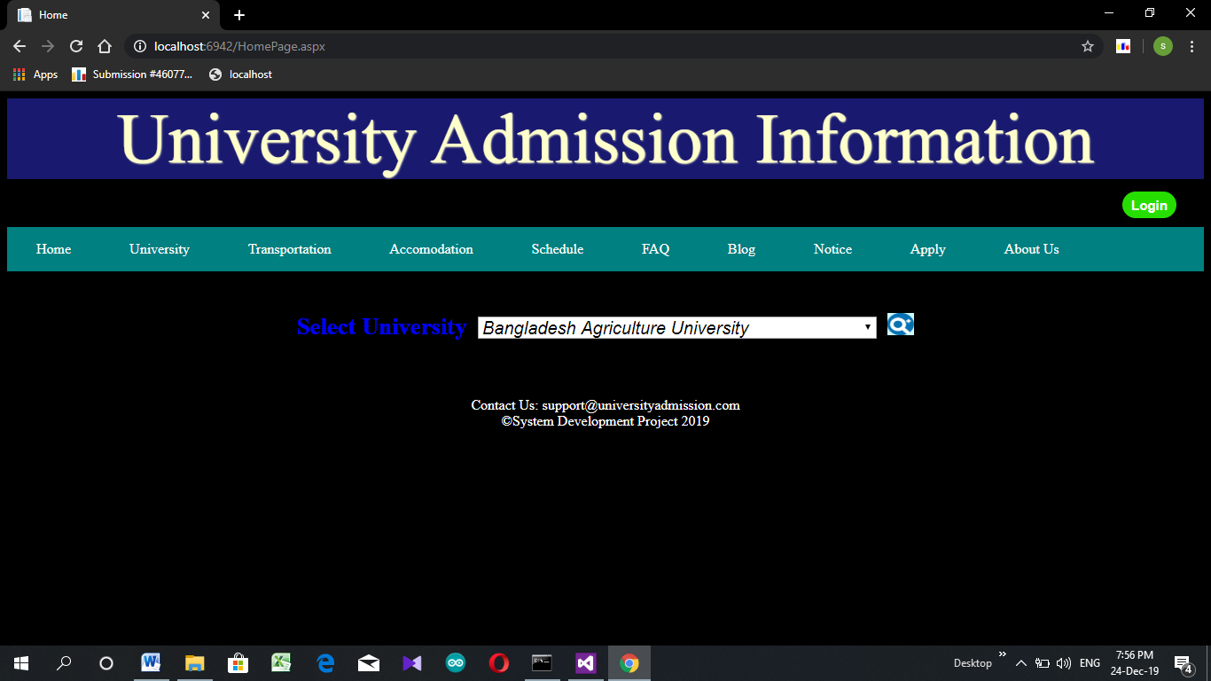
University Admission Information
Features
Home Page

Slide 5
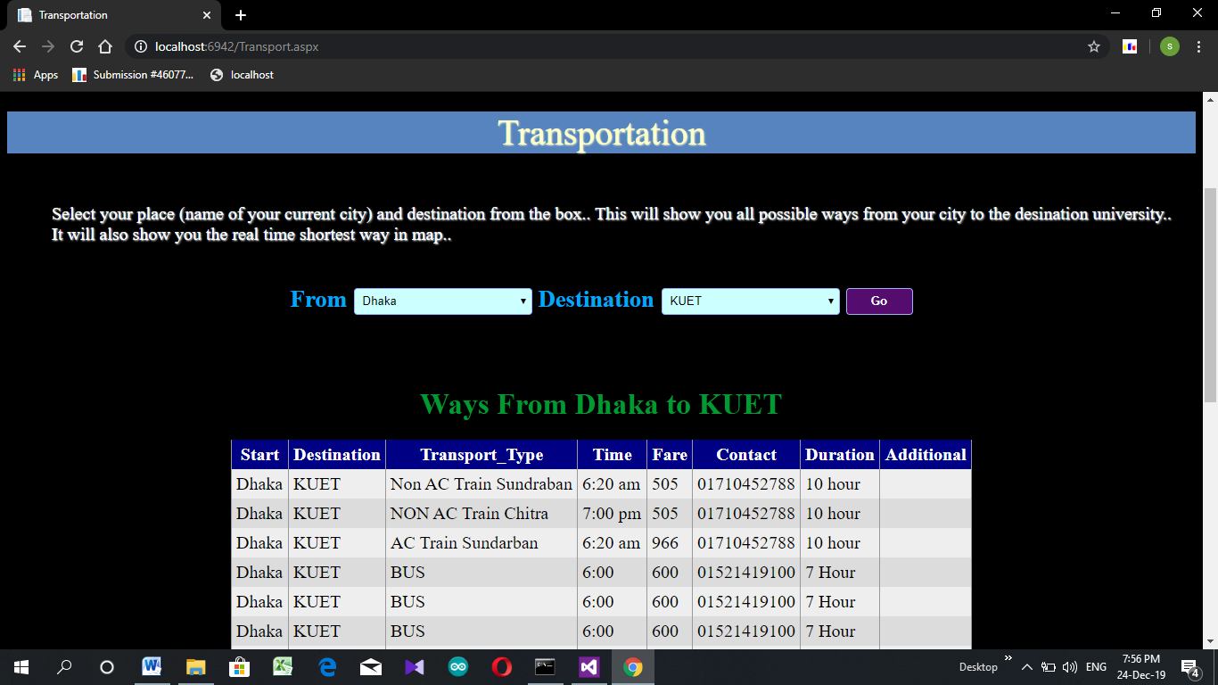
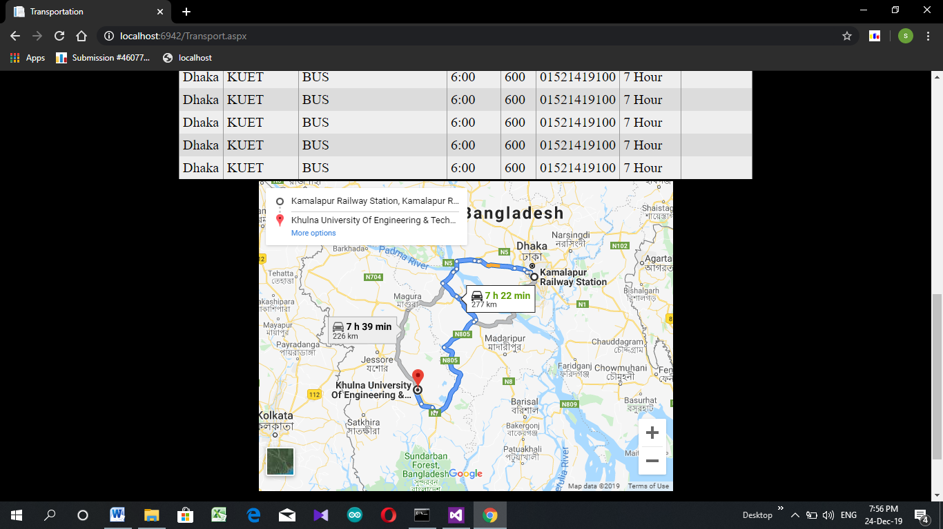
University Admission Information
Features
Transportation

Slide 6
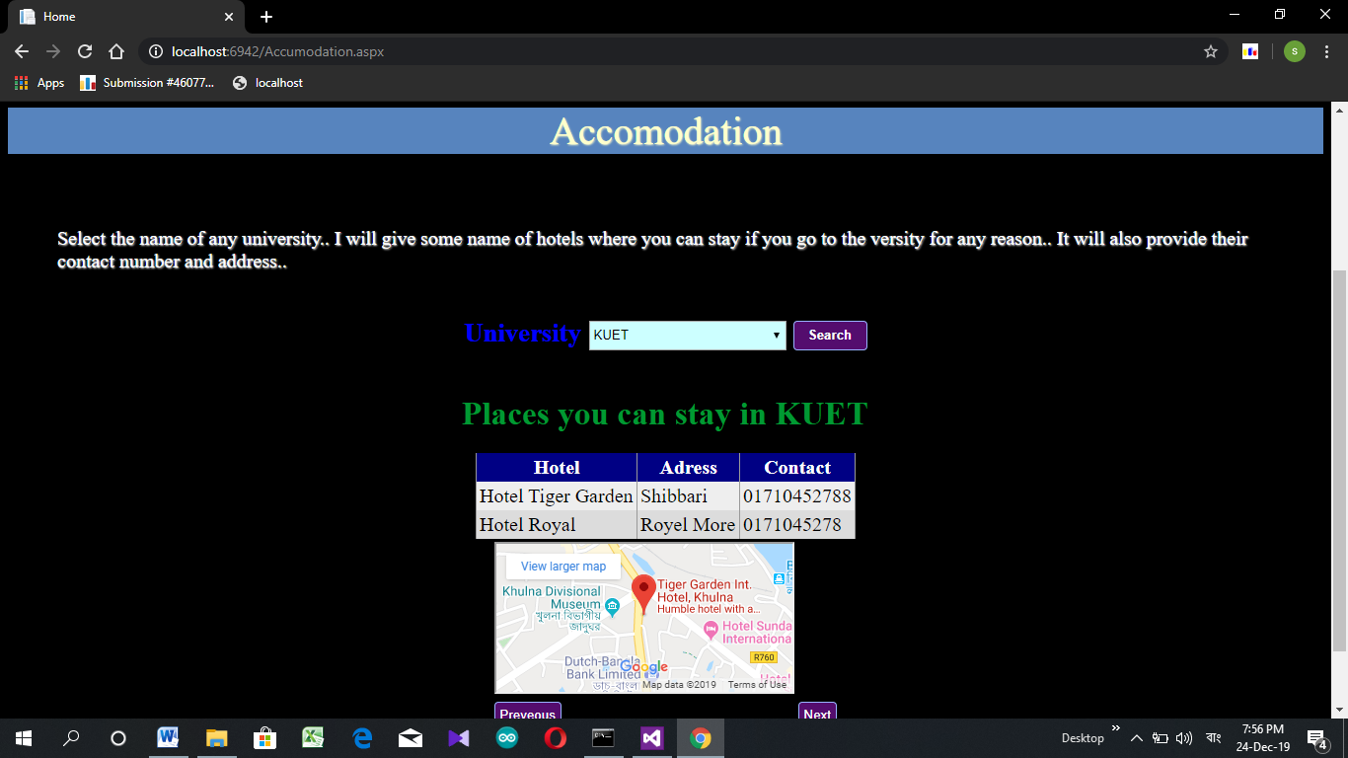
University Admission Information
Features
Accommodation

Slide 7
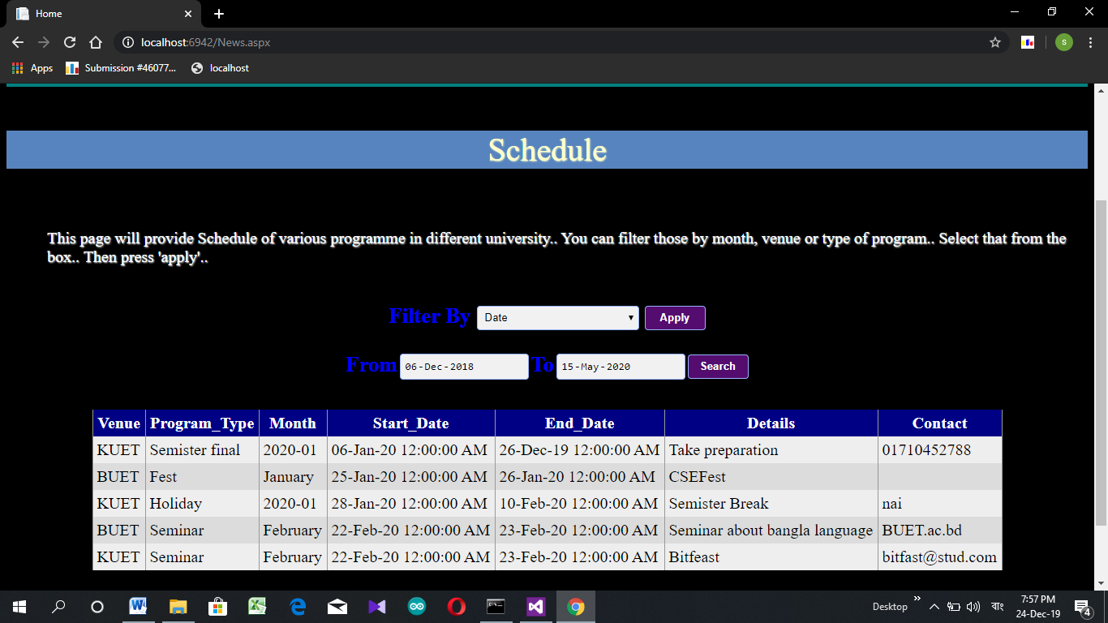
University Admission Information
Features
Schedule

Slide 8
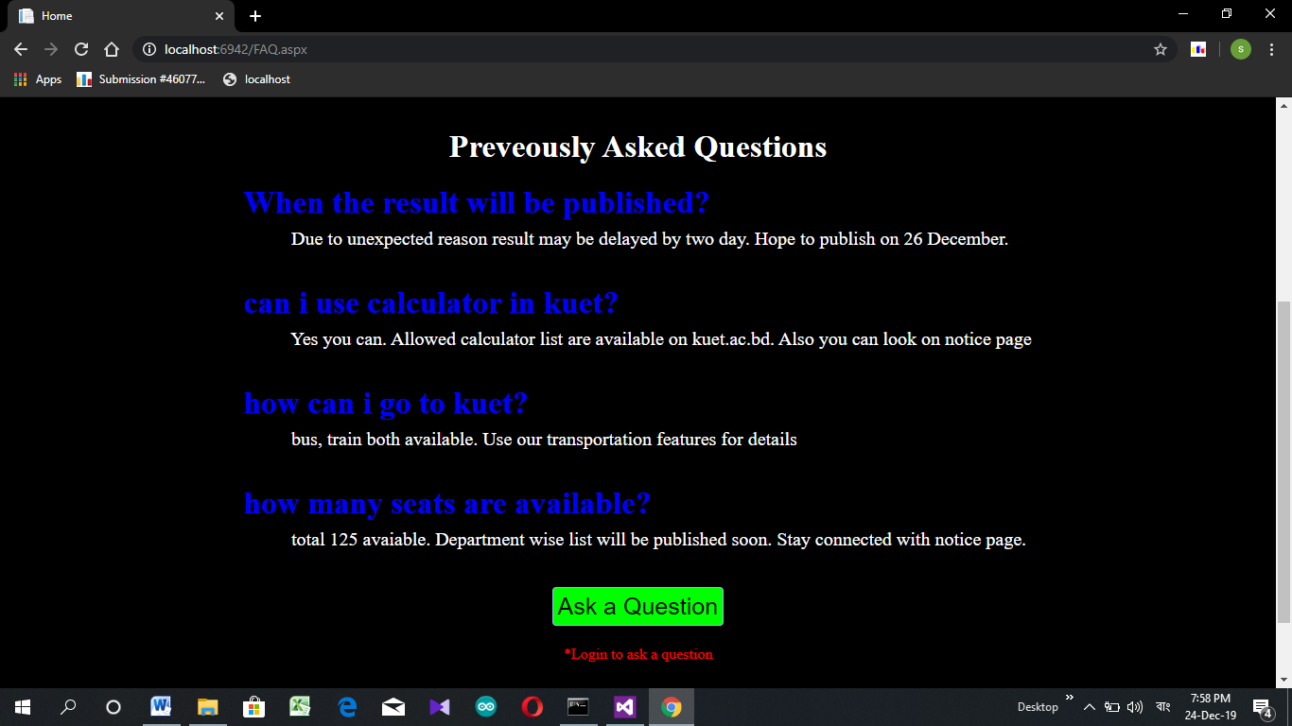
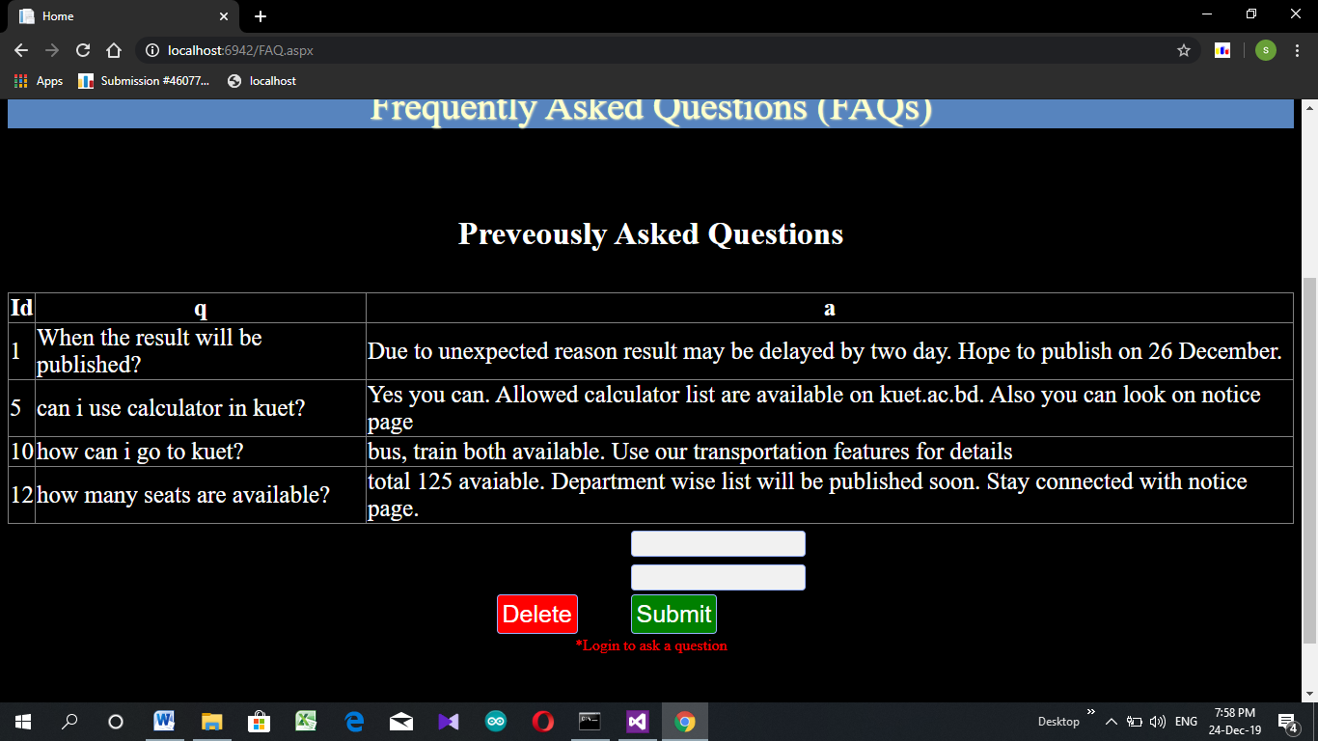
University Admission Information
Features
FAQ

Slide 9
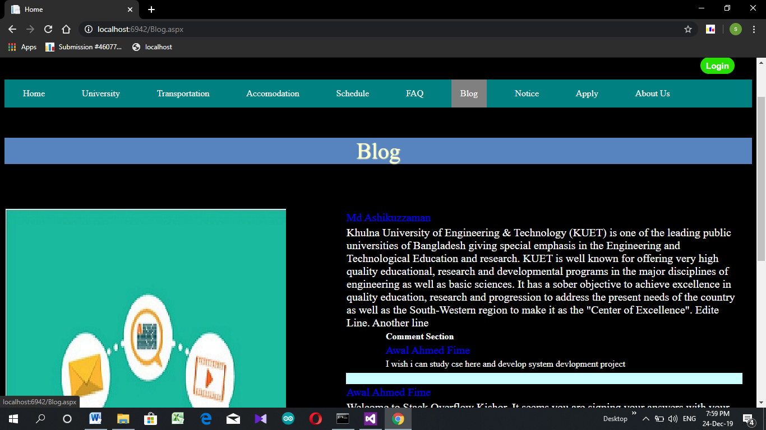
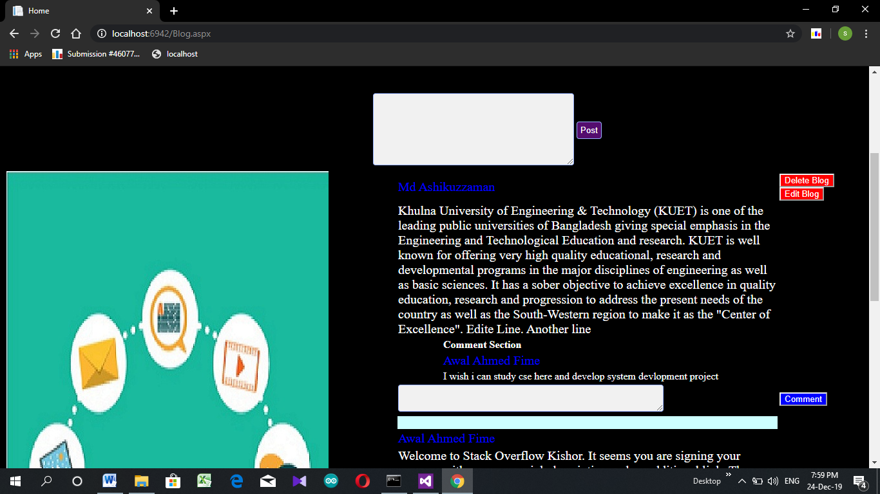
University Admission Information
Features
Blog

Slide 10
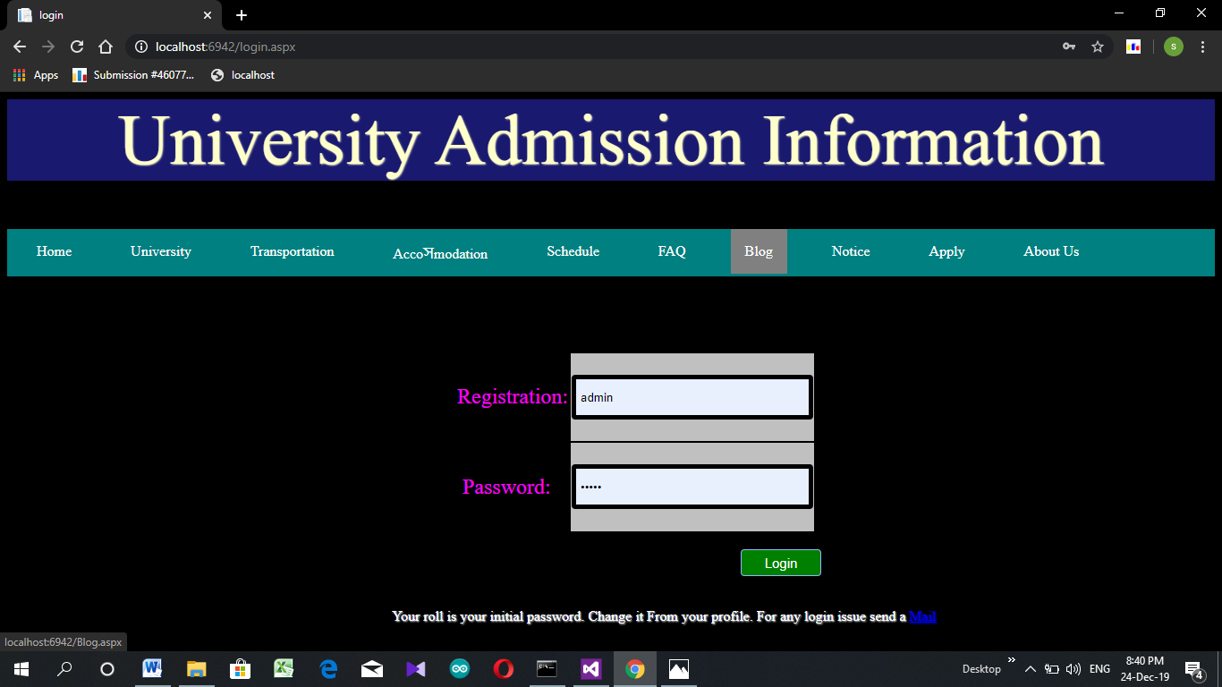
University Admission Information
Features
Login

Slide 11
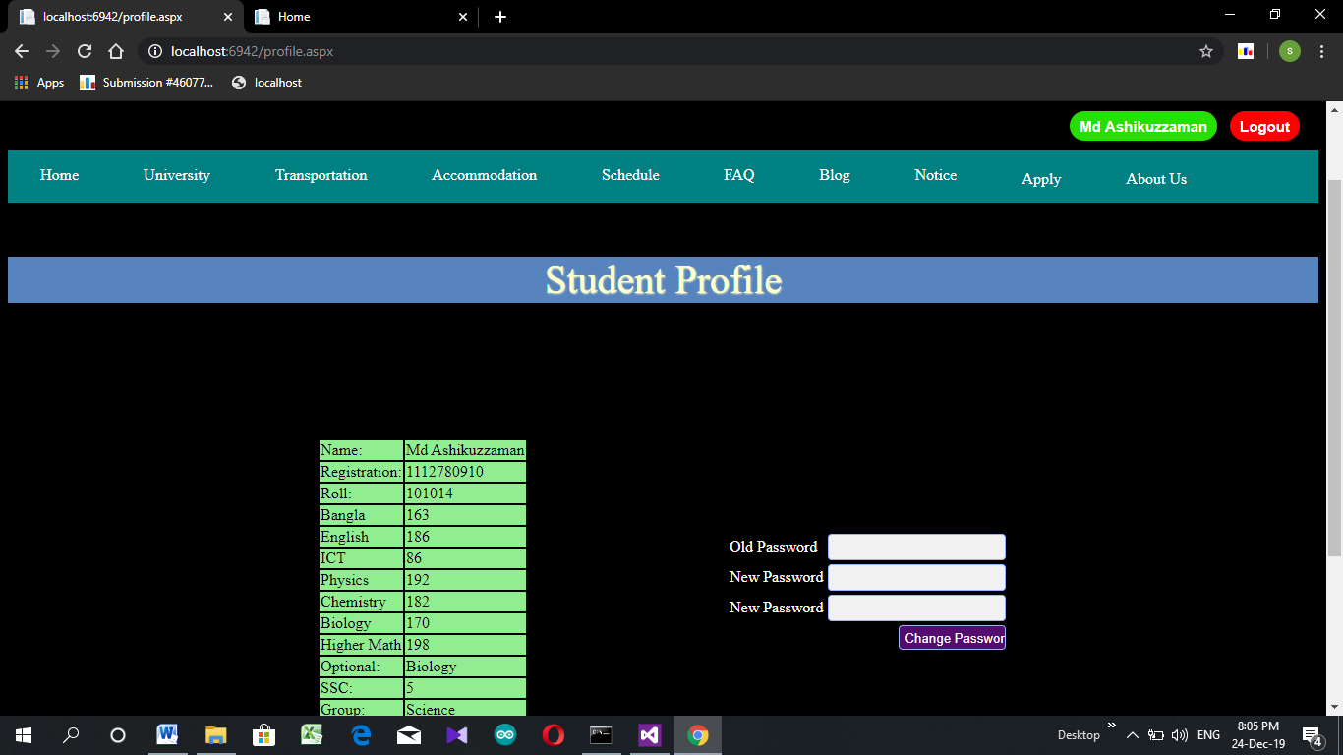
University Admission Information
Features
Student Profile

Slide 12
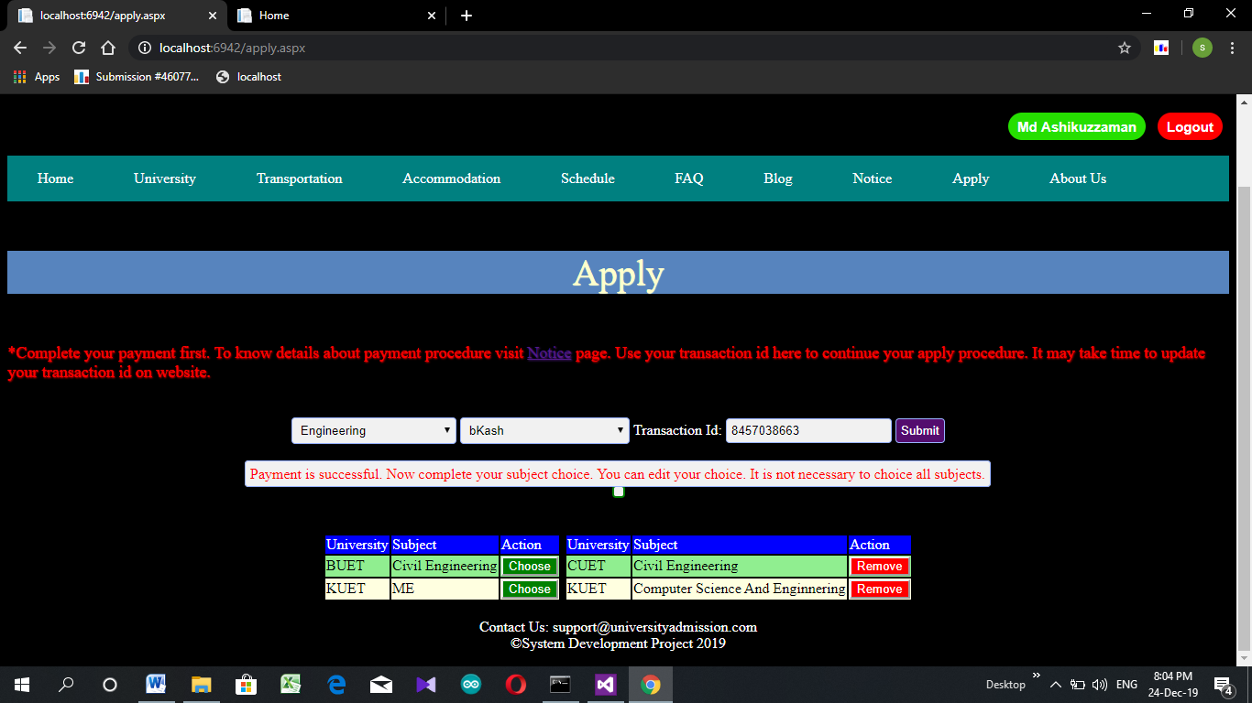
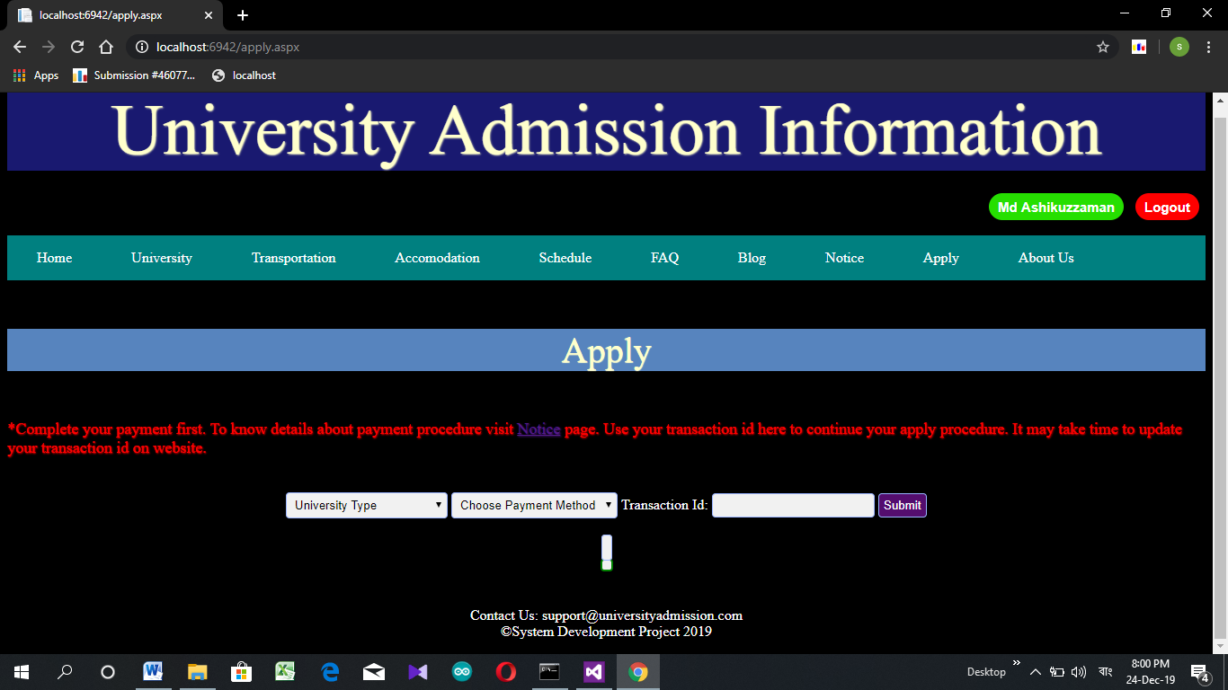
University Admission Information
Features
Apply

Slide 13
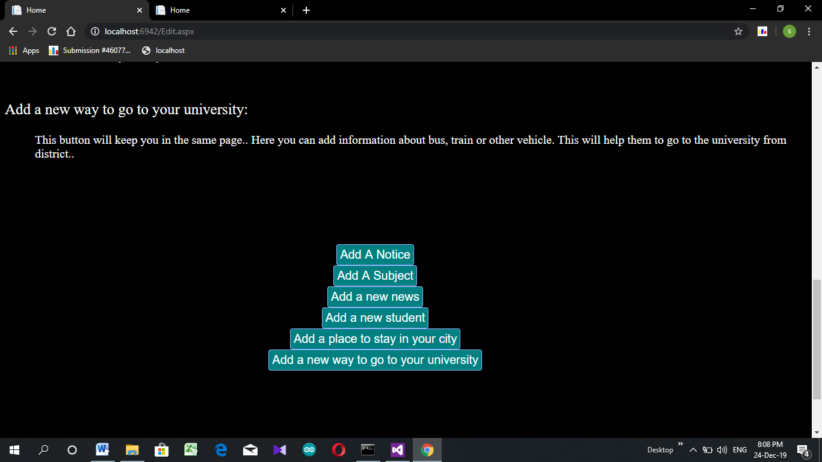
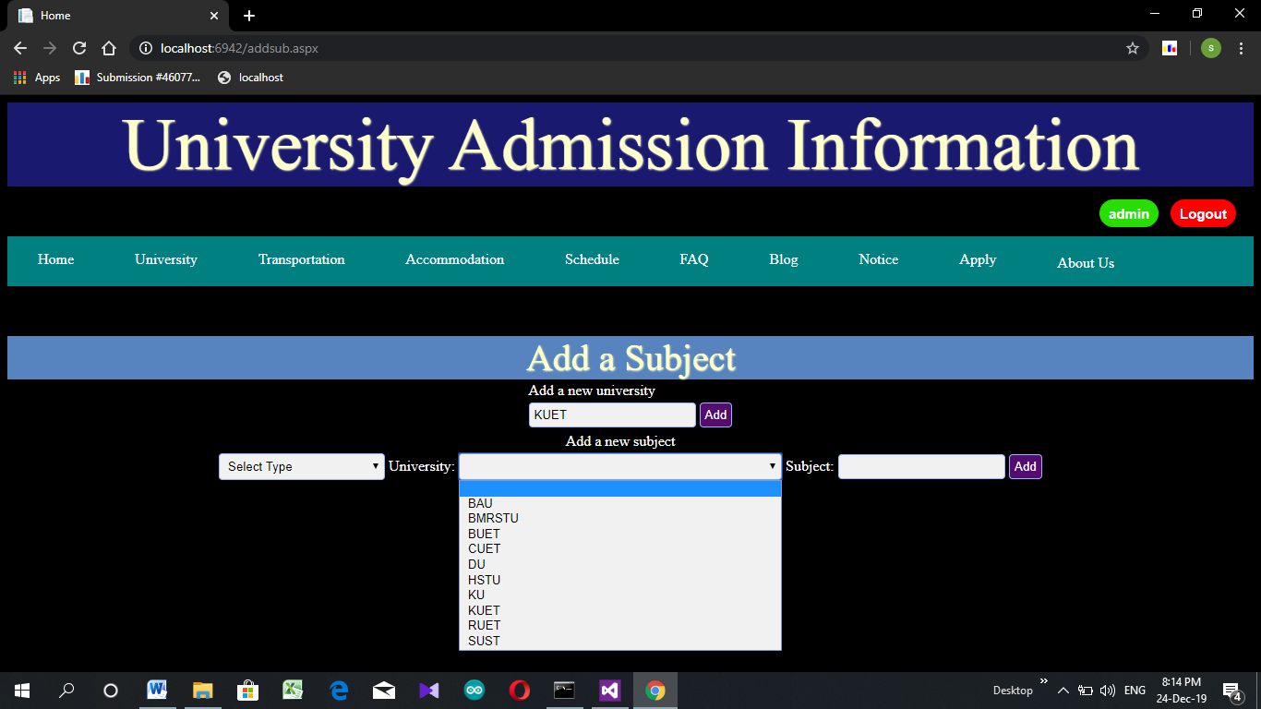
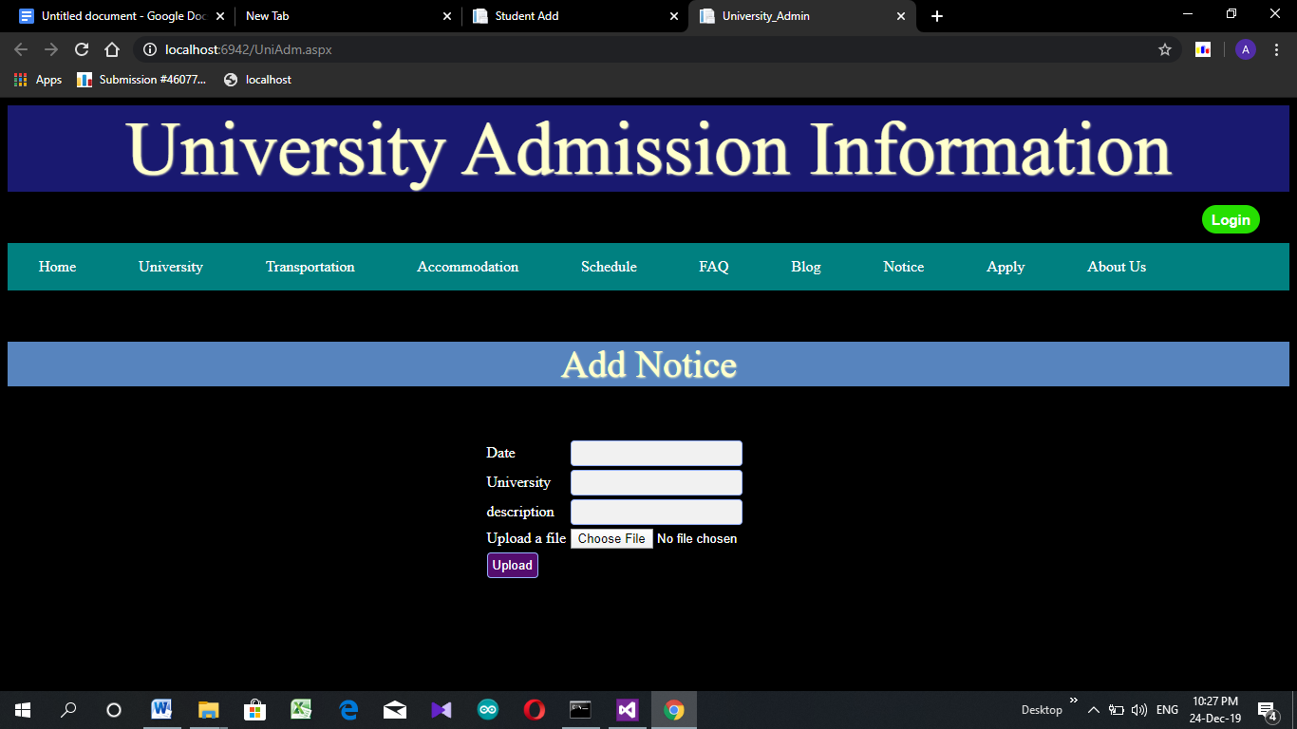
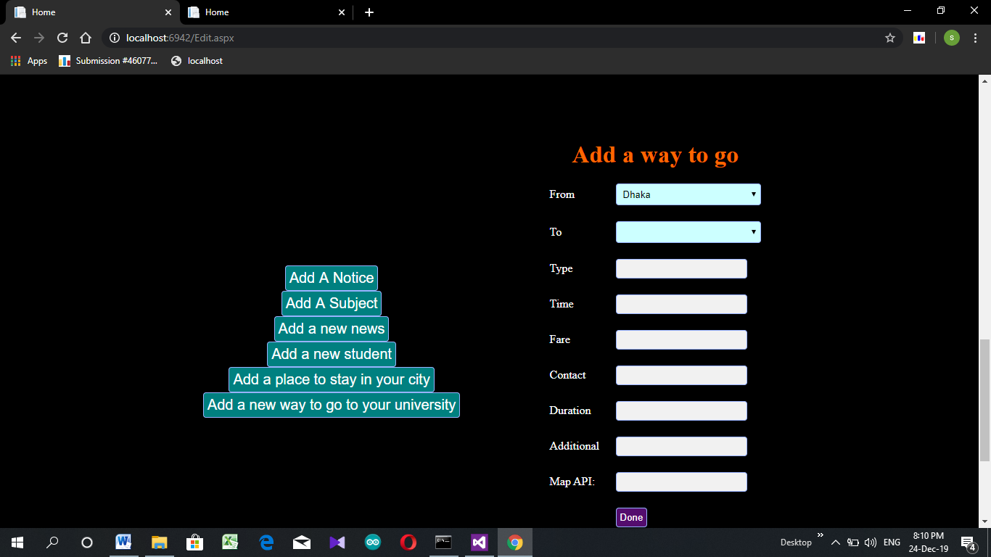
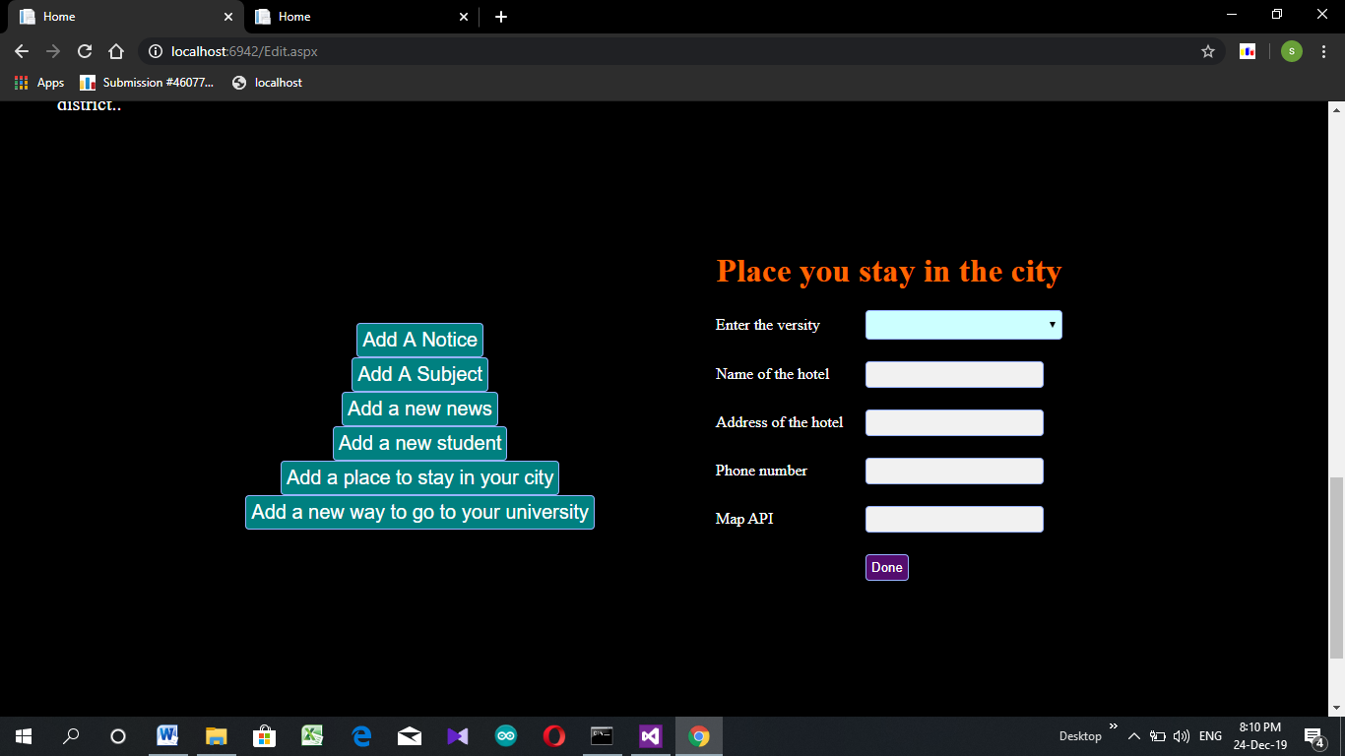
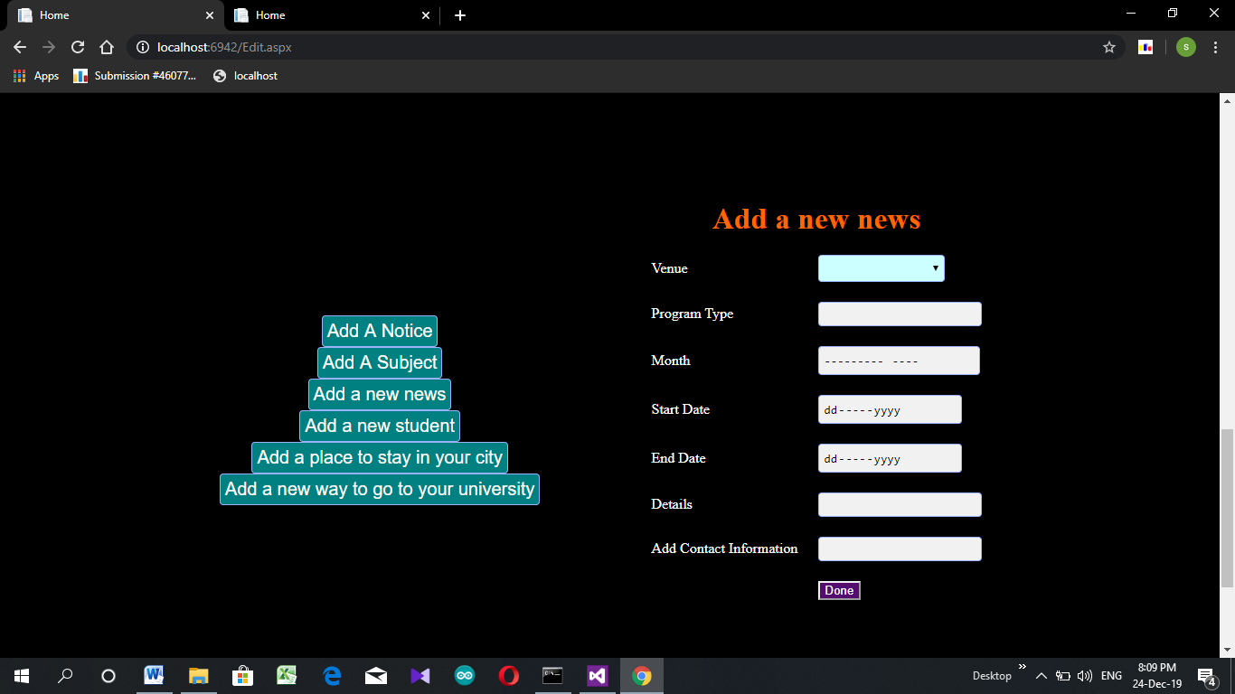
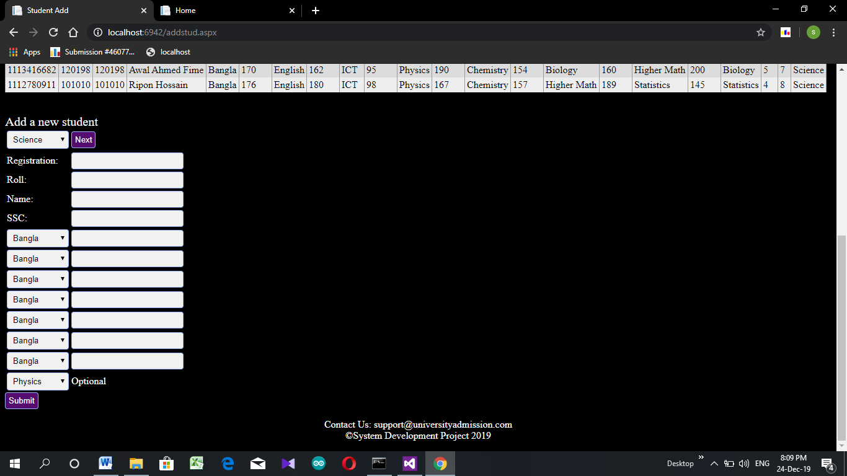
University Admission Information
Features
Admin Profile

Slide 14
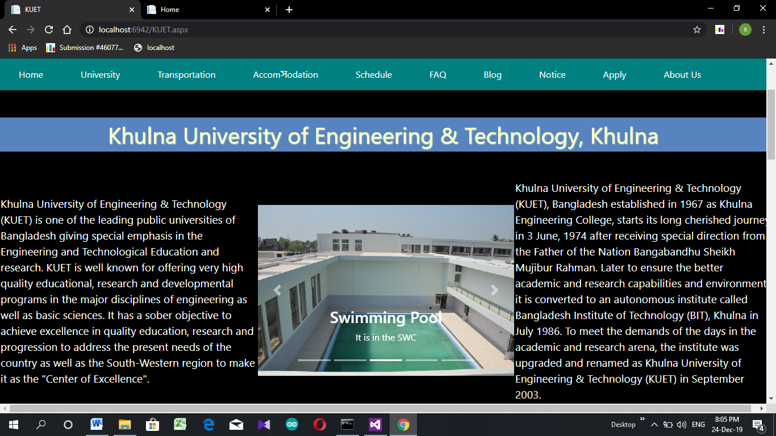
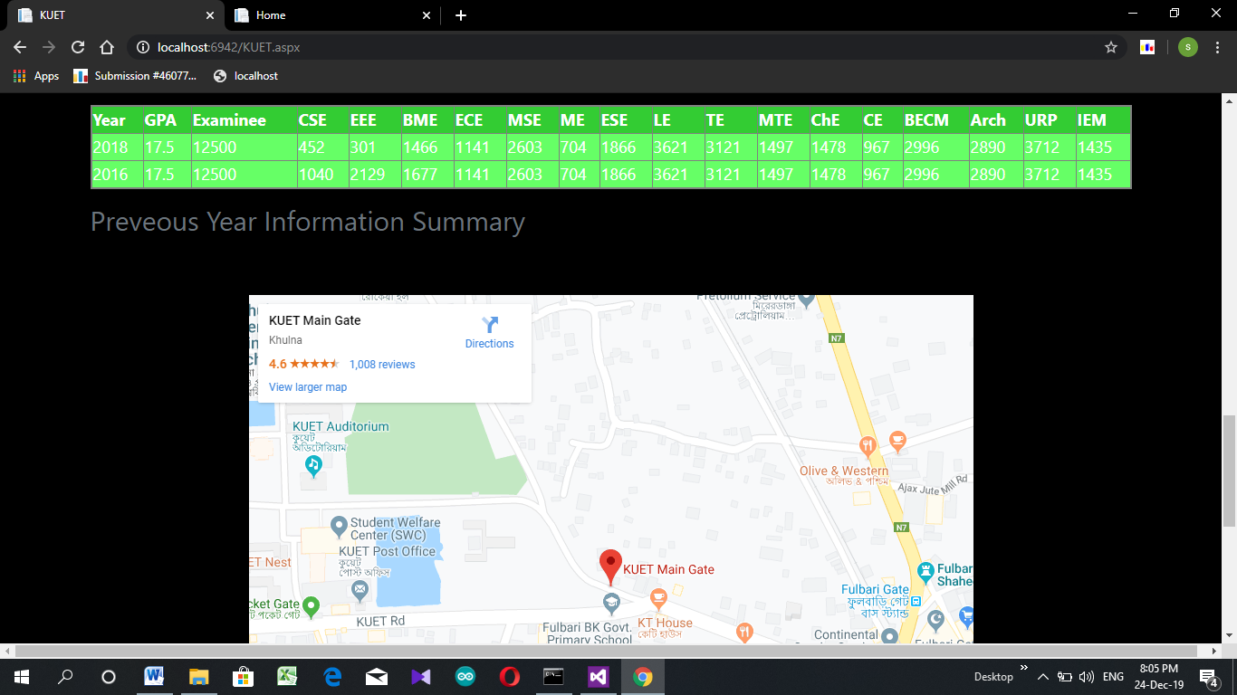
University Admission Information
Features
University Page

Slide 15
University Admission Information
Developing Tools
Framework:
ASP.NET
IDE:
Microsoft Visual Studio
Version:
2012
Debugging Browser:
Google Chrome

Slide 16
University Admission Information
Developing Tools
Client Site:
Hyper Text Markup Language (HTML)
Cascading Style Sheet
Bootstrap
Server Site:
C#
JavaScript
Database:
Microsoft SQL Server Database

Slide 17
University Admission Information
Thank You
Developed by
Md. Ashikuzzaman Awal Ahmed Fime
Roll:1607080 Roll:1607079
Department of CSE, KUET

